Slide 1

West Texas & Panhandle Region
Picture by J.Herrera
Bluebonnet 2019-2020
Notes:
Picture by Jessica Herrera 2019

Slide 2

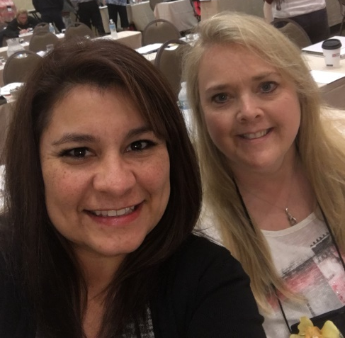
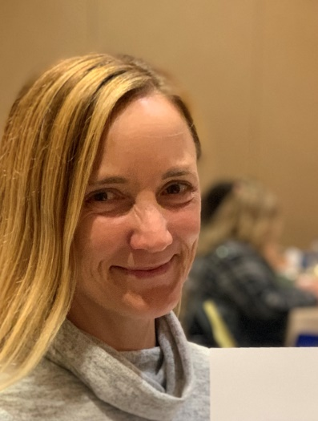

WesTpan Region Officers
Left to right
Vice President - Jessica Herrera BSN, RN, CPAN
President - Trina Mora MSN, RN, CAPA, CPAN
Secretary & Web Master
Kat Tollett BSN, RN, CNOR, CPAN, CST
Treasurer -
Carrie Watson BSN, RN, CAPA, CPAN

Slide 3

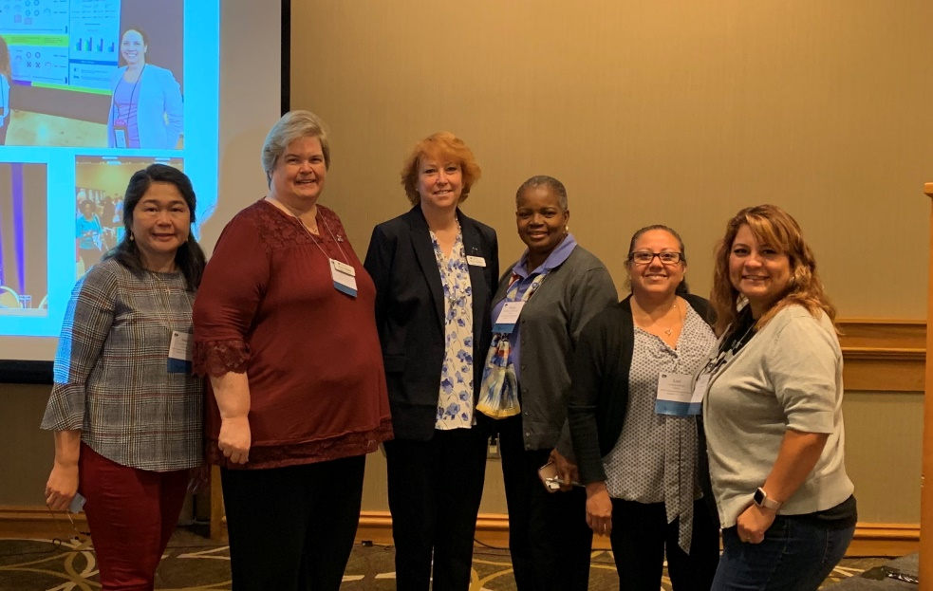
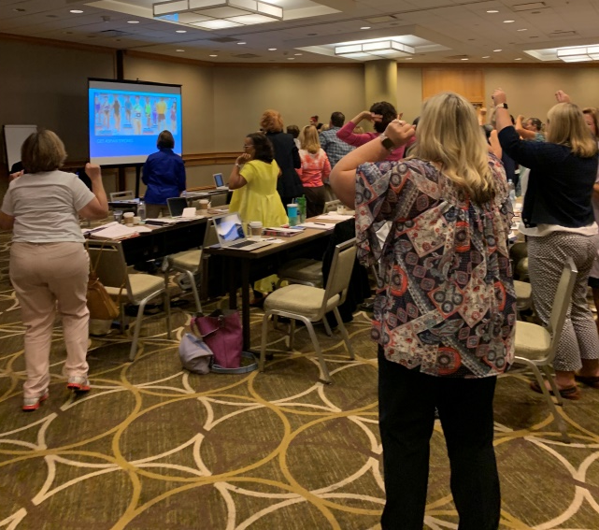
Component Development Institute
in Cincinnati, Ohio. September 13-15, 2019
Celebrate Strenght; Elevate Practice Going for Gold
Left to Right
Sonia Deleon, Susan Norris
Peggy McNeil guest speaker,
Fellicia Selman, Lori Rabago, and Jessica Herrera.
“ASPAN Strong, Get up and Move” presentation.
Notes:
Washington Park in Cincinnati, Ohio –Picture by Jessica Herrera
Each component of ASPAN is there to elevate their component with other ASPAN members.

Slide 4
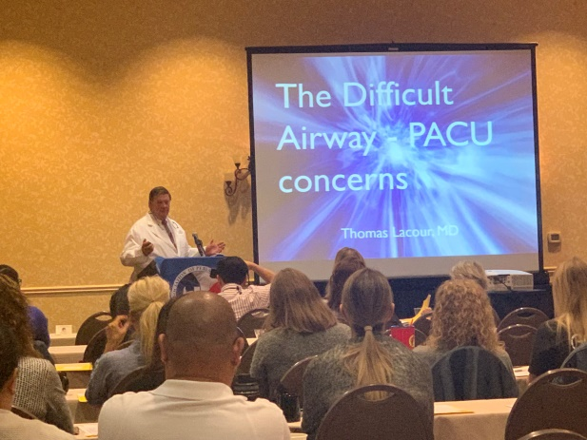
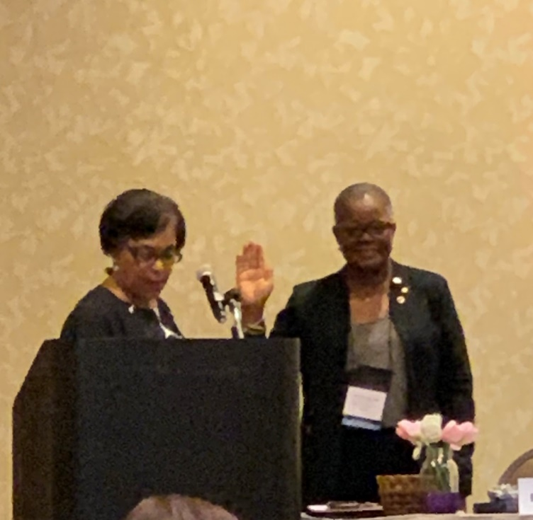
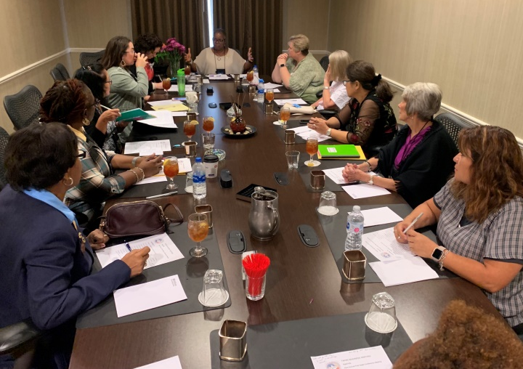
TAPAN 43nd Annual State Conference
September 27-29, 2019 in Lewisville, Texas
Guest Speaker Dr. Thomas Lacour
Immediate past president Deborah Davis
welcoming Felicia Selman to the
TAPAN President position.
TAPAN President Felicia Selman speaking after the State conference.

Slide 5
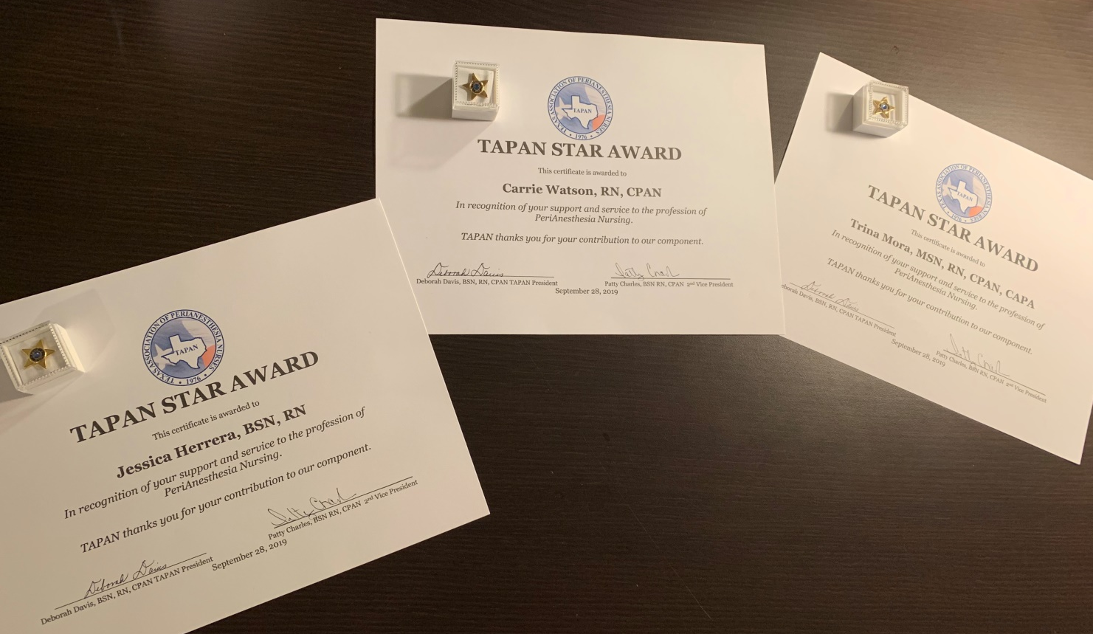
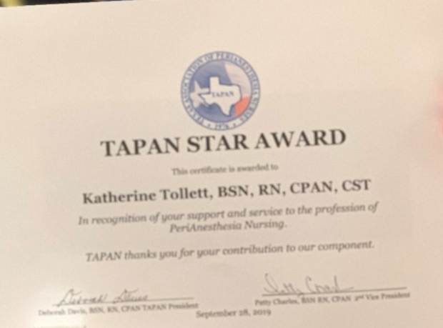
TAPAN 43nd Annual State Conference
September 27-29, 2019 in Lewisville, Texas
TAPAN STAR AWARD
All four of WesTpan Region Officers

Slide 6
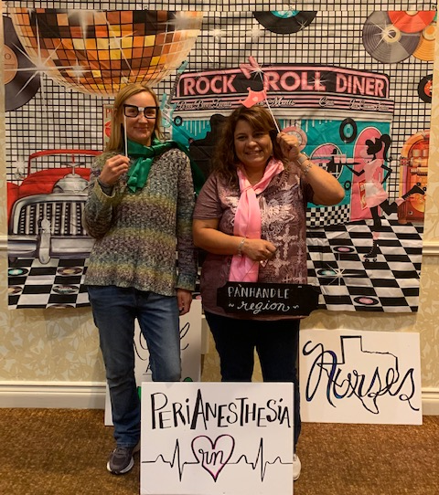
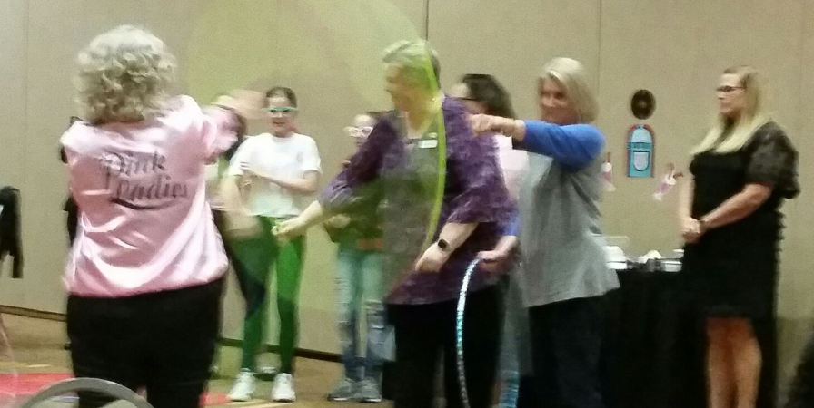

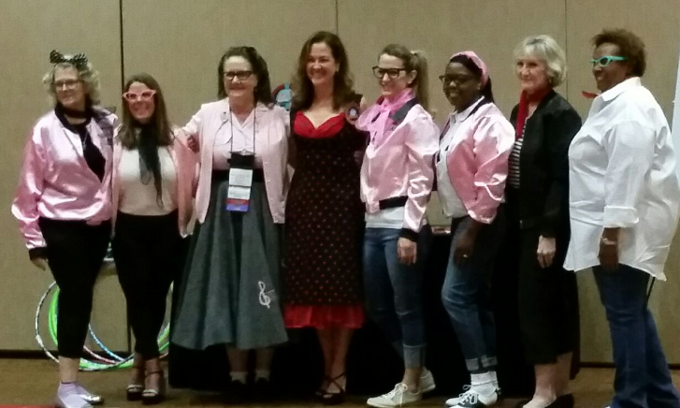
TAPAN 43nd Annual State Conference
September 27-29, 2019 in Lewisville, Texas
The President’s Dinner 50’s theme
Pictures by Kat Tollett and Ron Malit

Slide 7

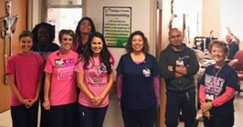
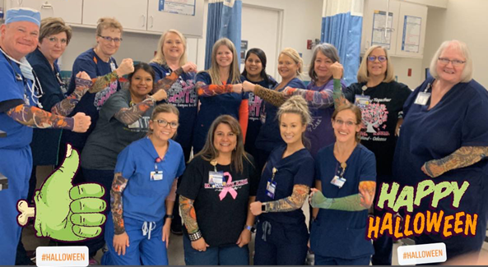
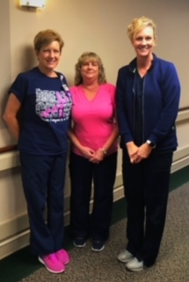
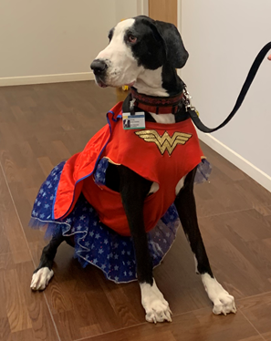
October 2019
Breast Cancer Awareness Month
And Halloween fun

Slide 8
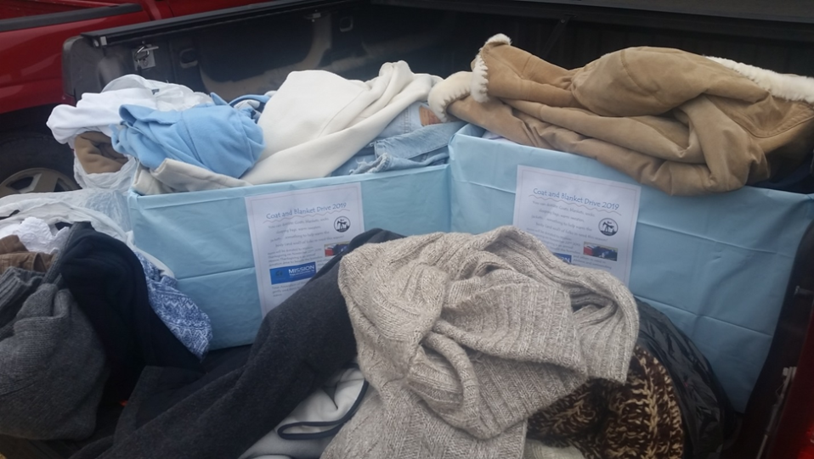
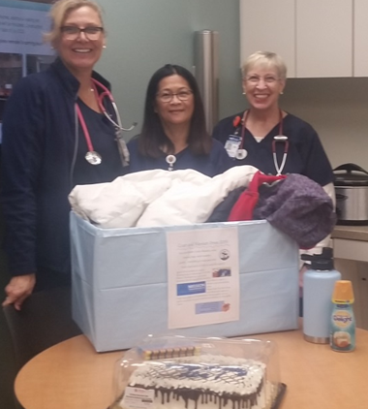
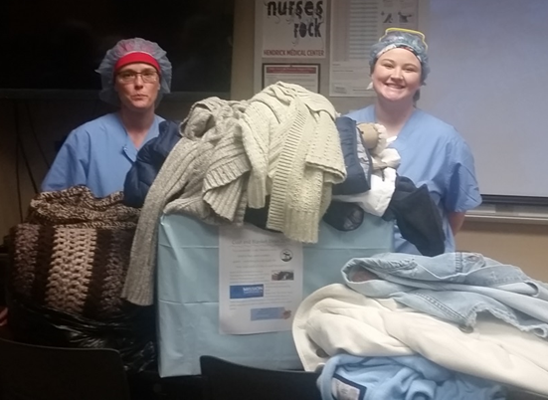
Mission Thanksgiving in Abilene
November 2019

Slide 9
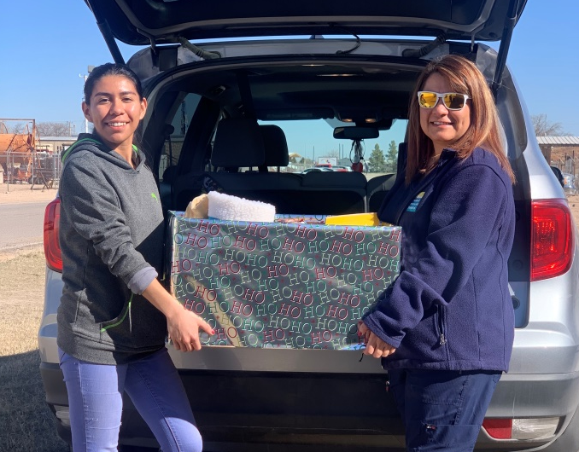
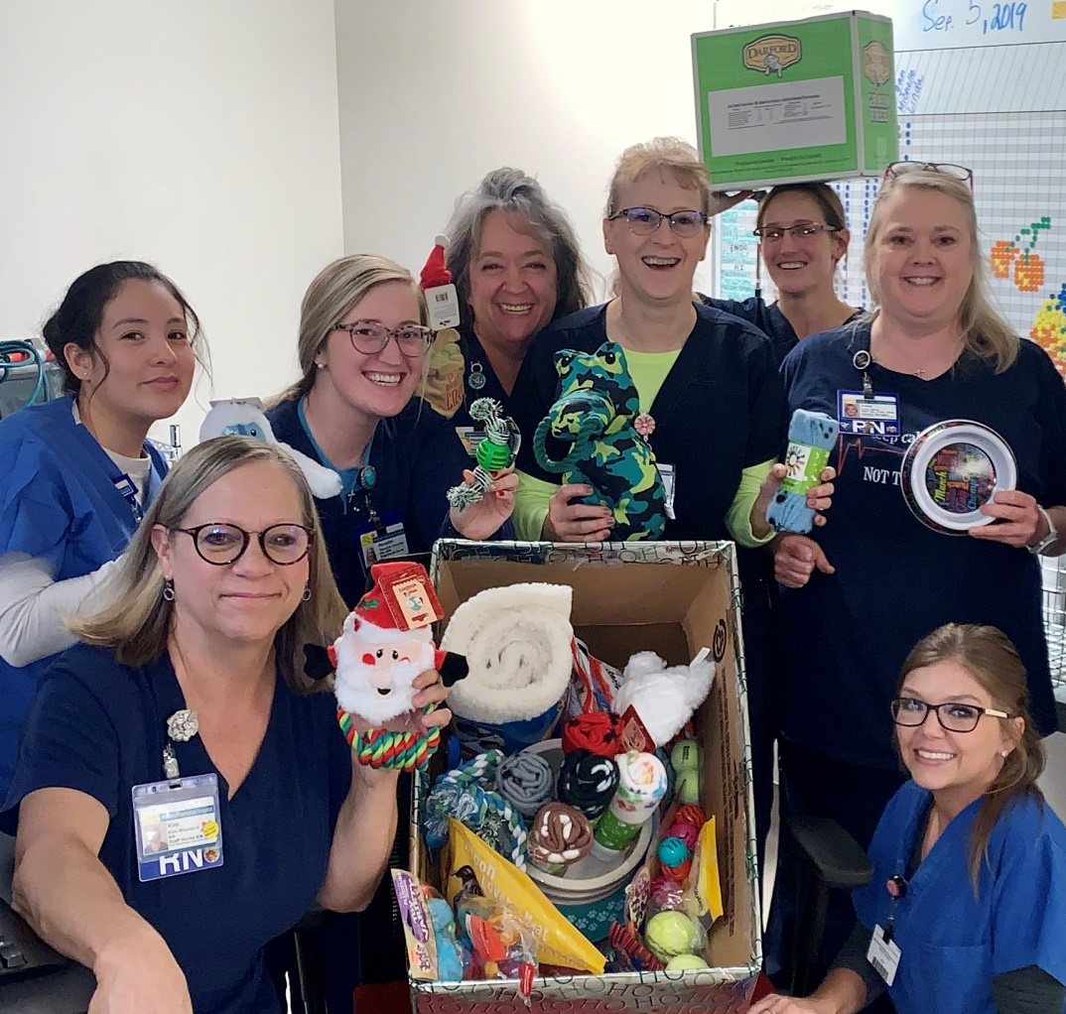
Paw’s for Celebration
3rd Annual fundraiser
December 2019

Slide 10
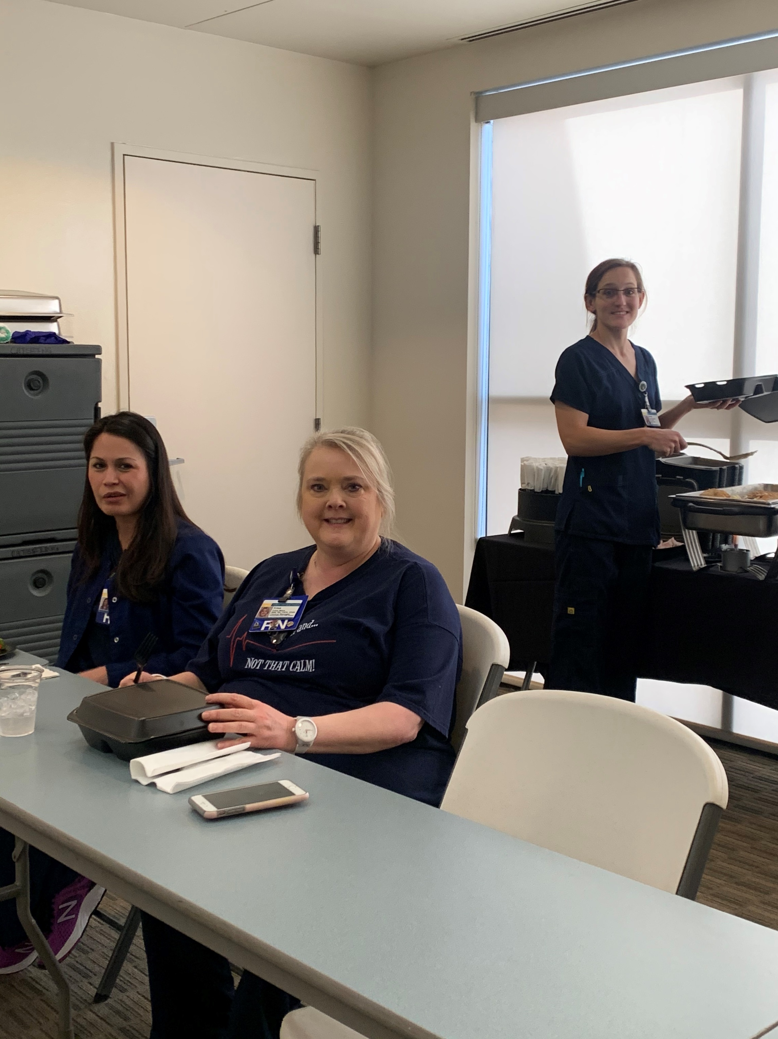
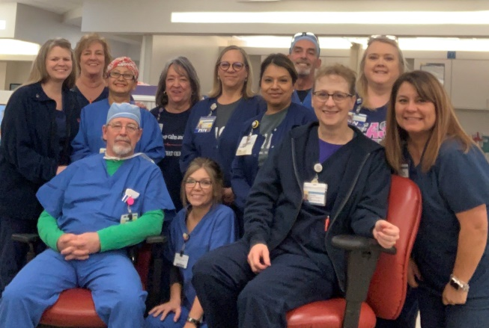
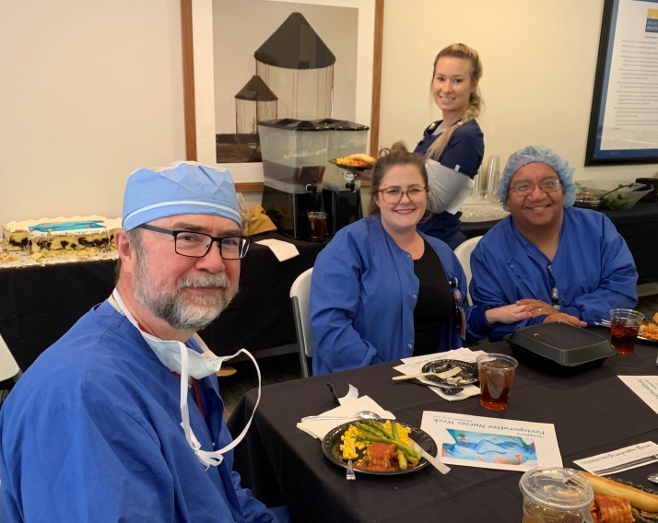
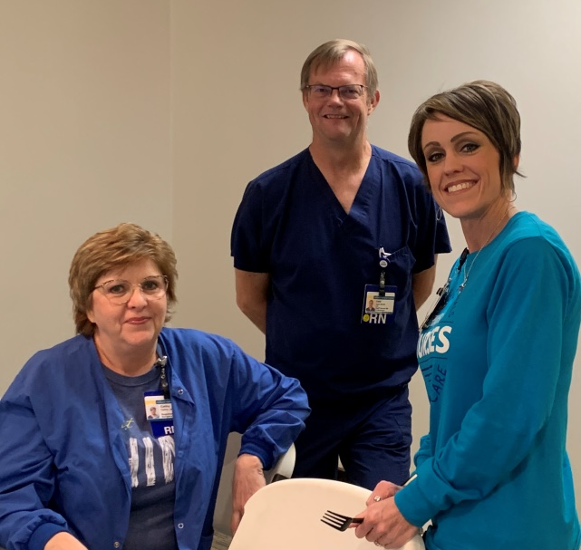

PeriAnesthesia Nurse Awareness Week
PANAW 2/2020

Slide 11
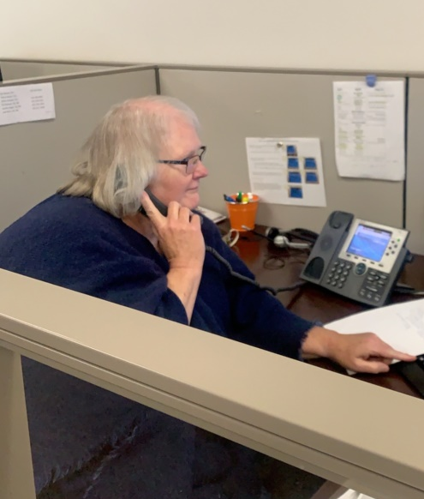
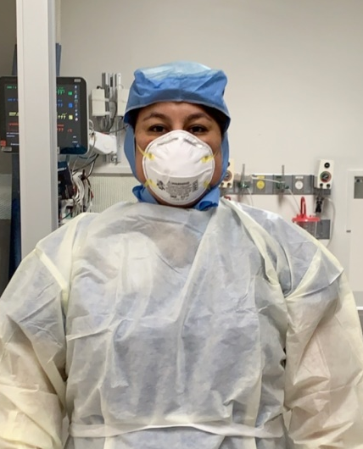
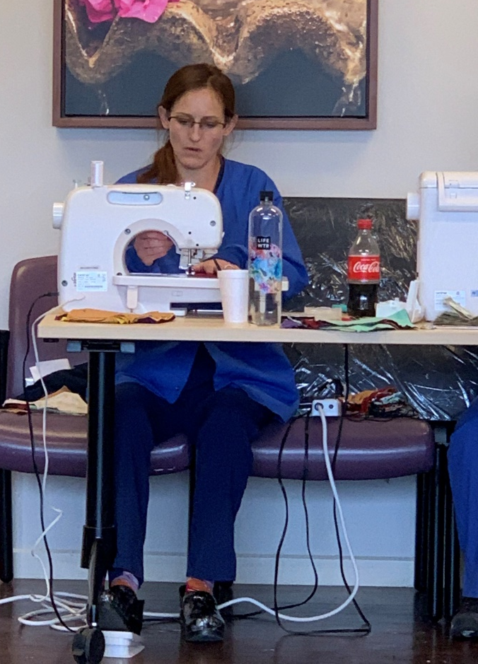
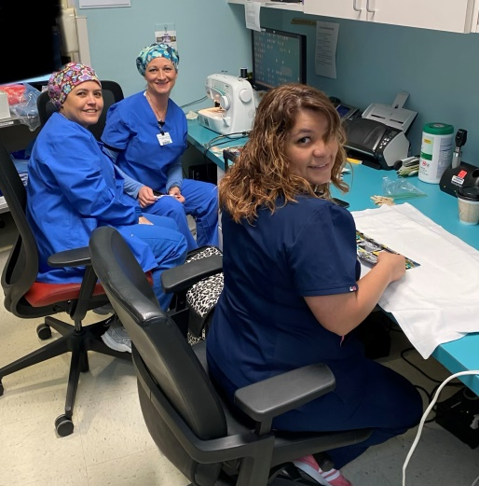
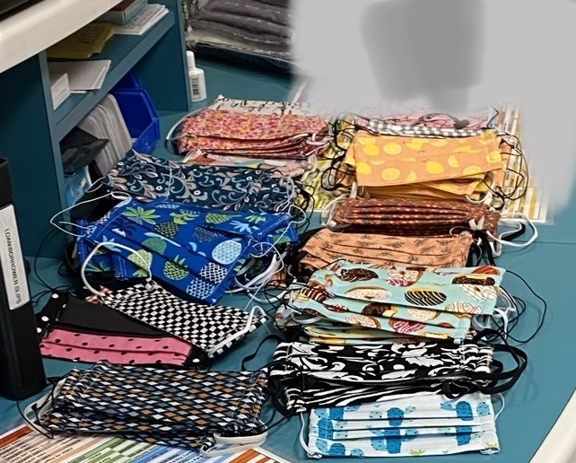
Start of COVID-19
March 2020

Slide 12


ASPAN National Conference 2020
U.S. Department of Health and Human Services Centers for Disease Control and Prevention Summary for Healthcare Facilities: Strategies for Optimizing the Supply of N95 Respirators during the COVID-19 Response
Notes:
Reference:
https://www.aspan.org/Portals/6/docs/Events/Conference/2020/ASPAN National Conference Canceled.pdf?ver=2020-03-17-161011-193

Slide 13
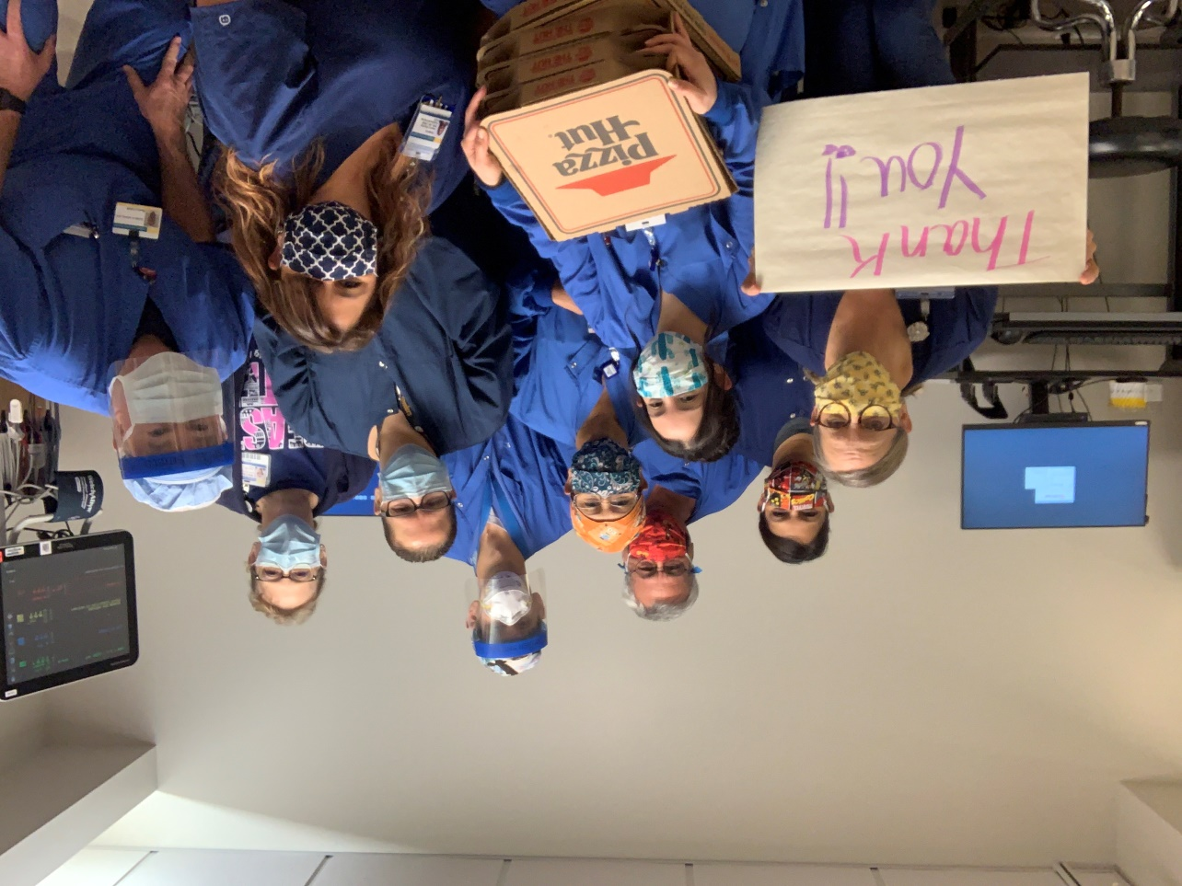
Friends feeding PACU
During COVID-19
April 2020

